Slide 1

The Research Manifold
Slides: soc-n.us/270126-research-manifold
Min-Yen Kan
National University of Singapore

Slide 2
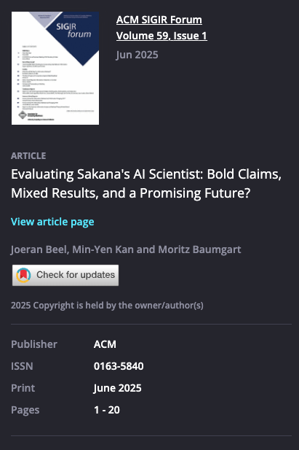
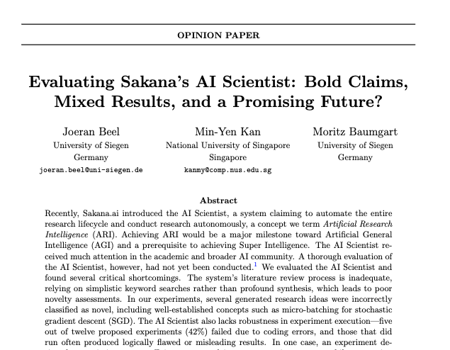
Slides: soc-n.us/270126-research-manifold
Beel et al. ACM SIGIR Forum 59(1): 1-20

Slide 3
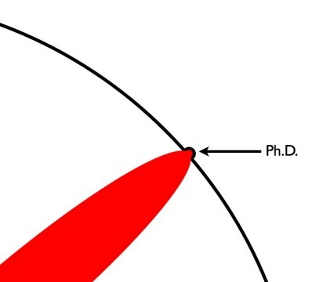
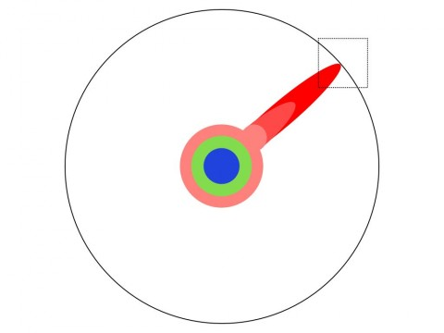
The Research Manifold
Images originally from Matt Might, U. Utah (CS & Internal Medicine)

Slide 4
Loss function of research

Slide 5

Particle Research
p5.js software credit: Louis Hoebregts

Slide 6
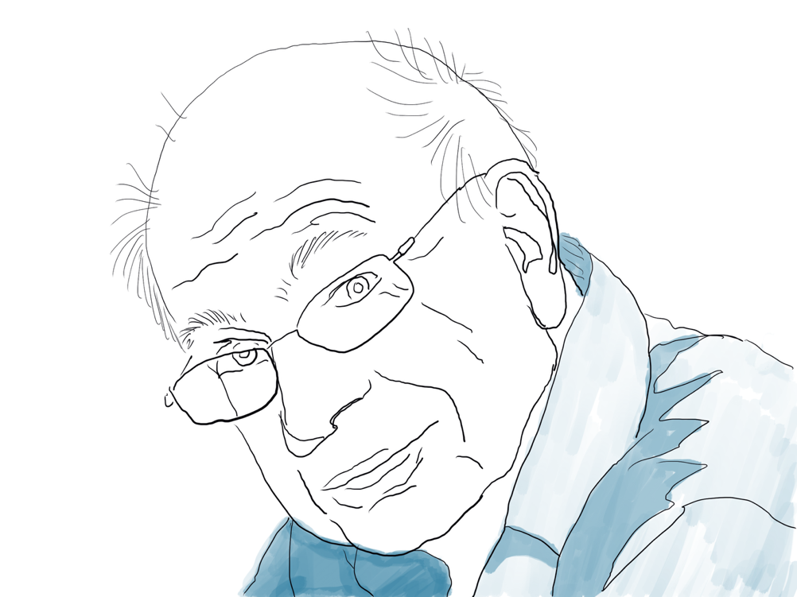
Research Fast and Slow
System 1 – Intuitive and Fast
System 2 – Deliberative and Slow
Daniel Kahneman

Slide 7
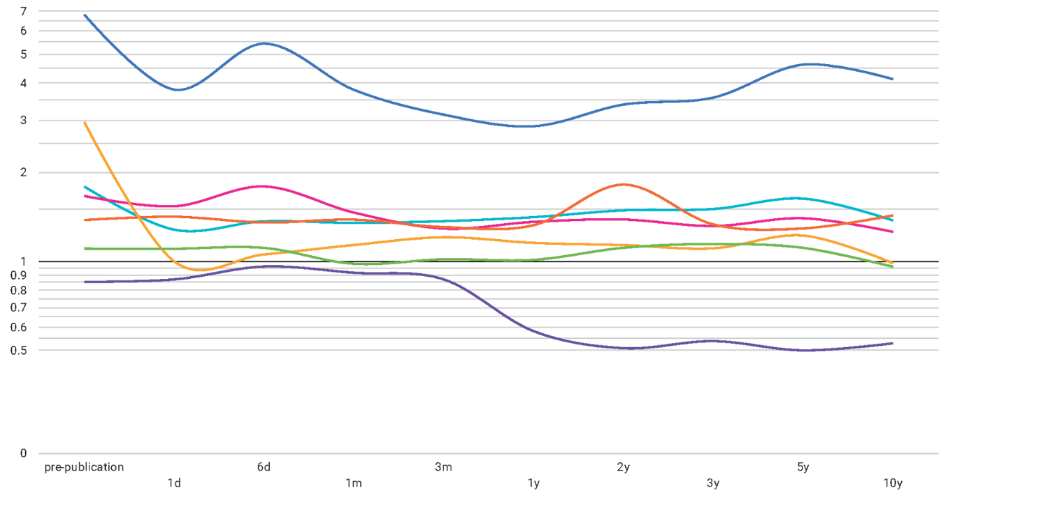
Research Faster
Timeline of attention in 2018
News outlets pick up the research
Key
News
Wikipedia
Facebook Walls
Reddit
Patent citations
Blogs
Policy
People read, comment and blog about it
Patents may precede publication
Wikipedia articles are updated with references
People bookmark and share on social media networks
Citations in policy documents appear
Renewed attention on other social media
Average attention
Research published
Days
Months
Years
Time since publication
Slide courtesy: Kathryn Weber-Boer, Altmetric and Dimensions

Slide 8
Research Too Fast?
We have our own age of accelerations for research
1. arXiv – 驚輸 “kiasu”
2. GitHub / Jupyter Notebook
3. Shared Tasks
4. Metrics and Loss Tuning
Image courtesy Recursion Pharmaceuticals
Notes:
Ready Fire Aim

Slide 9
Accelerations
Overload favors the convenient
But scholars can’t do random restart
Suboptimal local minima

Slide 10
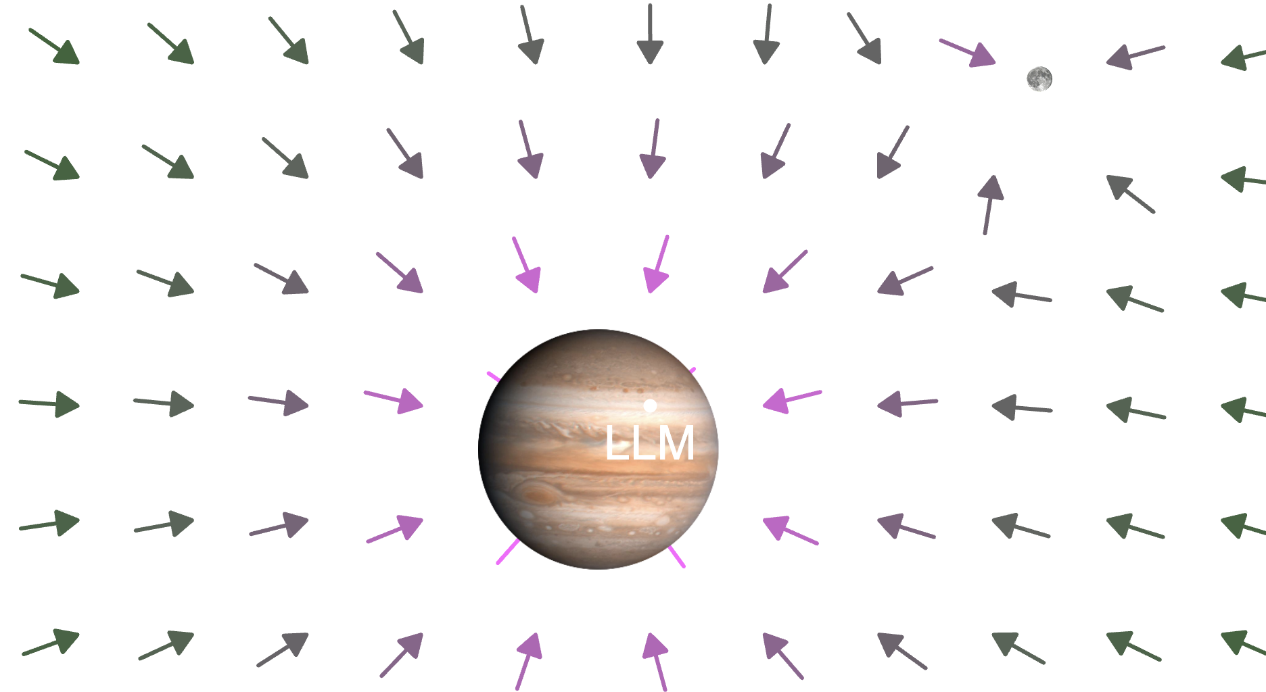
Regression to the Mean
Try it yourself: Moisés López Caeiro’s city44lmmc at Desmos
Notes:
Fiddle with massesNc

Slide 11
OUTLINE
The Research Manifold
Where Good Ideas Come From
Reasoning in Green and Red
The Year of the Centaur

Slide 12
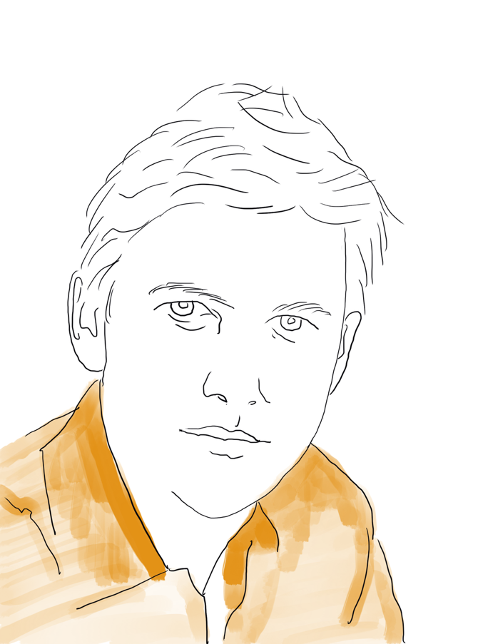
Where Good Ideas Come From
The Adjacent Possible
Liquid Networks
The Slow Hunch
Serendipity
Error
Exaptation
Platforms
Steven Johnson
Notes:
Fractal Patterns

Slide 13
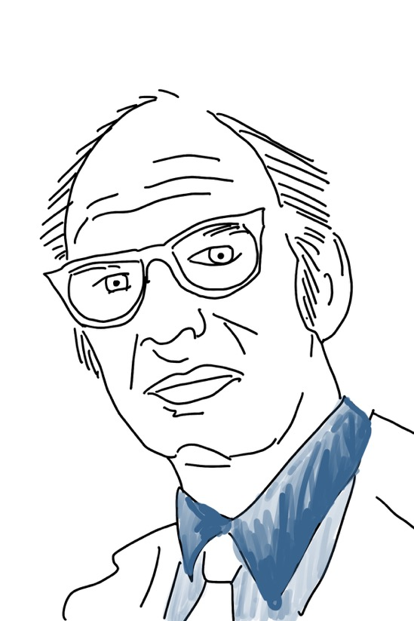
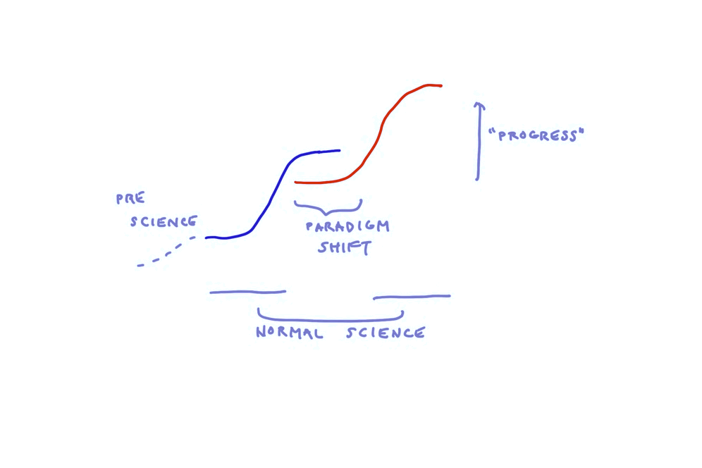
Kuhn – challenging accumulative growth
Kuhn, The Structure of Scientific Revolutions
Paradigm Shift
Normal Science
To think about: What role does AI play? What role do we play?
Thomas Kuhn

Slide 14
System 3 Innovation
Welcome Serendipity Chance favours the connected mind. We remain open to the unexpected.
Embrace Error Mistakes are not shameful; they are paths to discovery. We learn by falling forward.
Practice Exaptation We take from one craft and use it in another. Adaptation is strength.
Build on Platforms Innovation grows atop shared foundations. What we create, we leave for others to climb higher.
Explore the Adjacent Possible We step where the next door opens. Progress builds one threshold at a time.
Form Liquid Networks Ideas flow like water, colliding and mixing in open networks. We do not innovate alone.
Trust the Slow Hunch Breakthroughs are not lightning strikes, but embers that burn over years. We tend them patiently.

Slide 15
Research Slow
Ignore the gradient: Open up the Adjacent Possible
Develops the Slow Hunch through persistent exposure to ancillary evidence
The Workshop: collision allows scholars to catalyse new ideas through ideation

Slide 16
OUTLINE
The Research Manifold
Where Good Ideas Come From
Reasoning in Green and Red
The Year of the Centaur

Slide 17
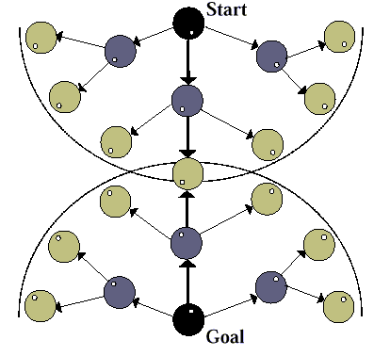
Adjacent Possible as Reasoning
You can’t invent the microwave in 1650. It’s beyond the bounds of possibility.
Use simulation to roll out science’s potential events.

Slide 18
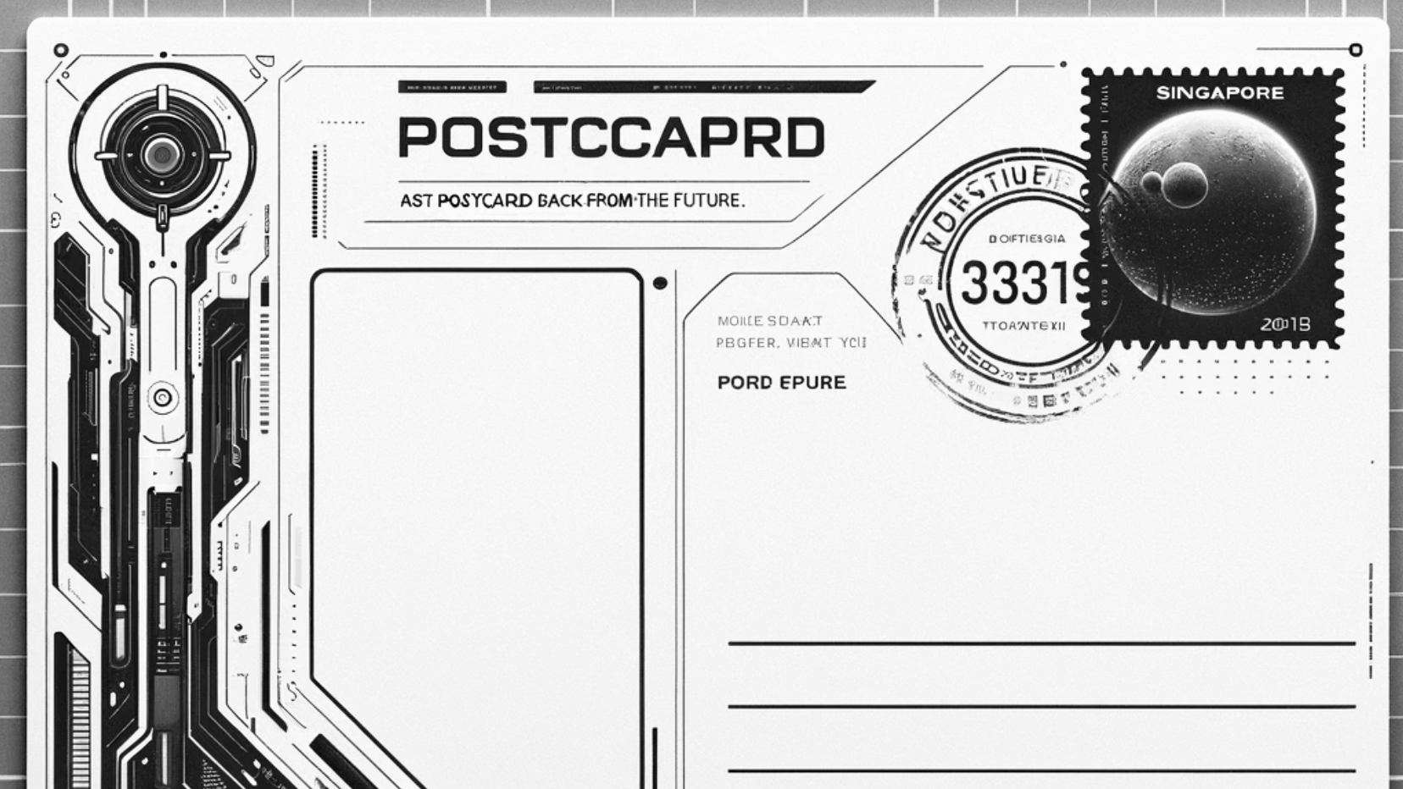
Postcards from the Future 2035
AI is prevalent across the globe. In your role, write a post-card to the other two roles telling them:
What you need or want from them
What you in your role can offer

Slide 19
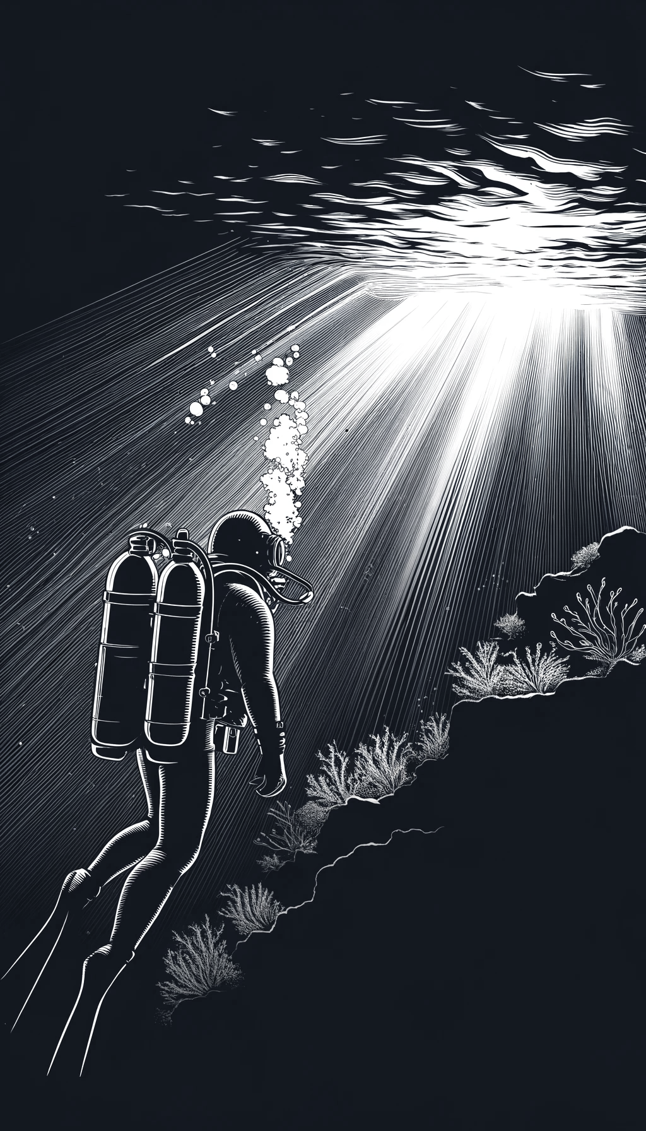

Slide 20
Strategy works best when we do it green light / red light.
(Green) Let your thoughts come unfettered.
Jot down any thoughts, then wander around, take a tangent

Slide 21
Strategy works best when we do it green light / red light.
(Red) Connect the motifs
Relate them back to your assigned role.
Synthesise your thoughts and write your postcard.

Slide 22
Bidirectional Search

Slide 23
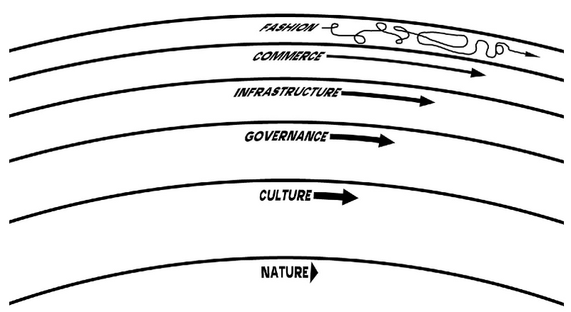
Wide Context: The Humboldian Model
Fast learns, slow remembers.
Fast proposes, slow disposes.
Fast is discontinuous, slow is continuous.
Fast and small instructs slow and big by accrued innovation and by occasional revolution.
Slow and big controls small and fast by constraint and constancy.
Fast gets all our attention, slow has all the power.
Steward Brand (2018) Pace Layering: How Complex Systems Learn and Keep Learning

Slide 24
OUTLINE
The Research Manifold
Where Good Ideas Come From
Reasoning in Green and Red
The Year of the Centaur

Slide 25

Generated by Nano Banana

Slide 26
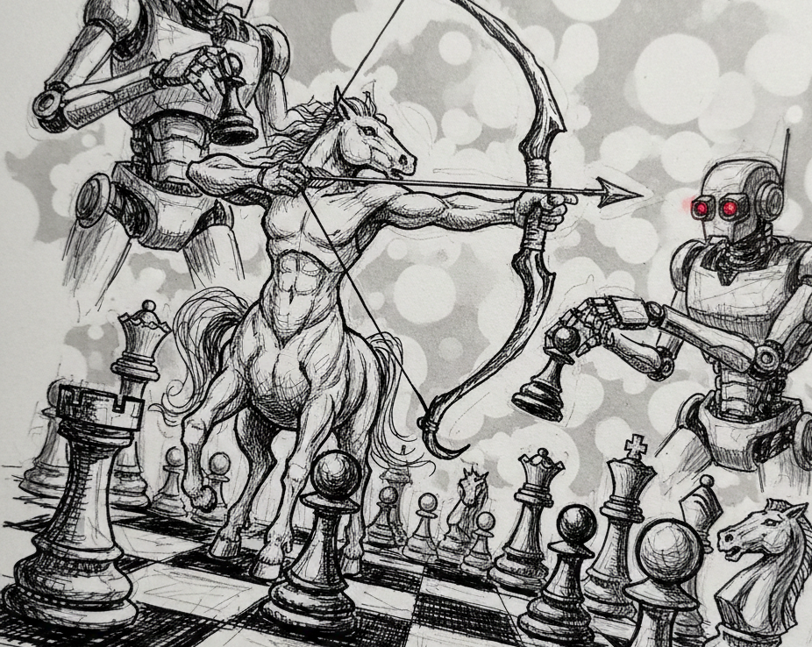
Lessons from Chess
Lessons from Advanced Chess
1. Origin: The Post-Deep Blue Era (1998)
2. Peak Performance: The 2005 “Freestyle” Surprise
3. Engine Supremacy (2026)
Generated by Nano Banana

Slide 27
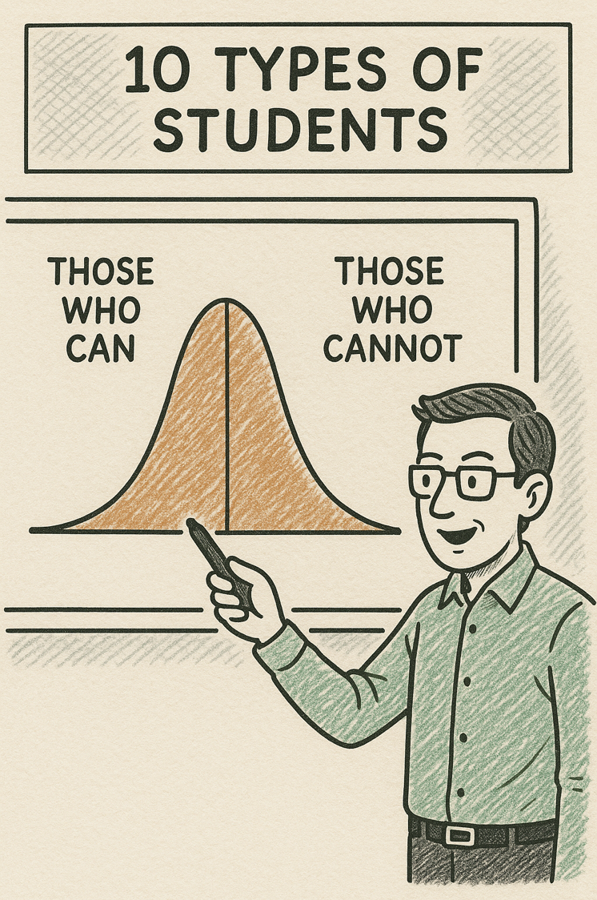
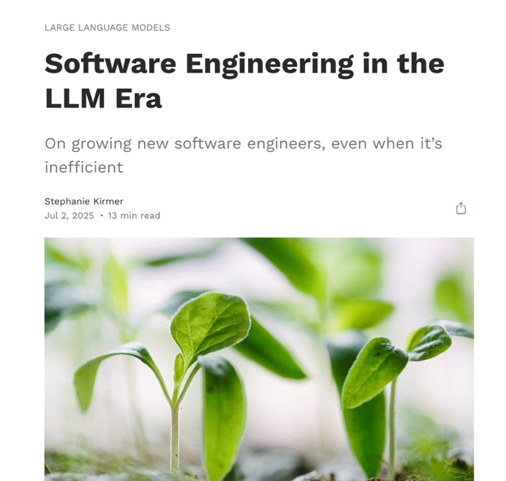
Junior Scholars with Agency
How do we ensure our scaffolding is sufficient to students to thrive and have agency, and not be disempowered?
Credit: Stephanie Kirmer (1 Jul 2025)
stephaniekirmer.com/writing/softwareengineeringinthellmera/

Slide 28
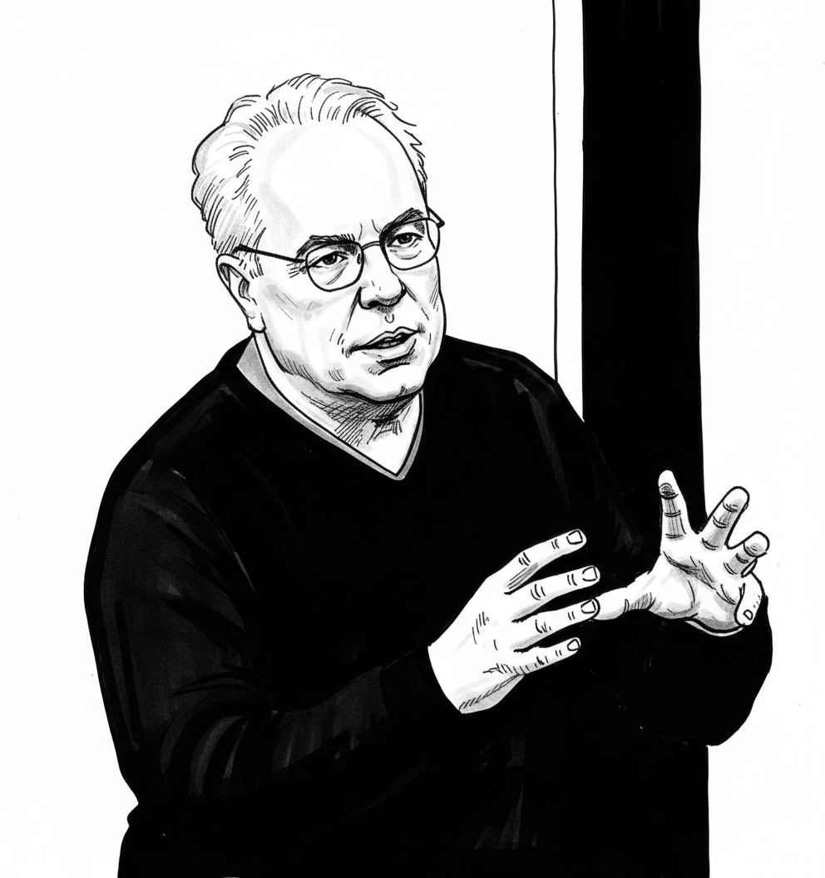
Vibe Coding as Technical Debt
Technical debt (or “tech debt”) is a software development concept representing the implied future cost of reworking a solution caused by choosing an easy, fast, or subpar, solution now instead of a better, more robust approach.
Laurence Moroney: Good debt exists. Where clear objectives are met, business value is delivered and there is human understanding.
Stanford CS230 | Autumn 2025 | Lecture 9 Career Advice in AI Screen capture modified by Nano Banana

Slide 29
AI Use as Cognitive Debt
CAUTION: NOT PEER REVIEWED
Sample Essay: Must our achievements benefit others in order to make us truly happy?
Four sessions over four months:
Brain connectivity systematically scaled down with the amount of external support: the Brain‑only group exhibited the strongest, … LLM assistance elicited the weakest overall coupling.
In session 4, LLM-to-Brain participants showed weaker neural connectivity and under-engagement of alpha and beta networks; and the Brain-to-LLM participants demonstrated higher memory recall, and re‑engagement of widespread occipito-parietal and prefrontal nodes, likely supporting the visual processing, similar to the one frequently perceived in the Search Engine group.
LLM | LLM | LLM | Brain
Search Engine | Search Engine | Search Engine | N/A
Brain | Brain | Brain | LLM
Kosmyna et al. (2025) Your Brain on ChatGPT. arXiv 2506:08872

Slide 30
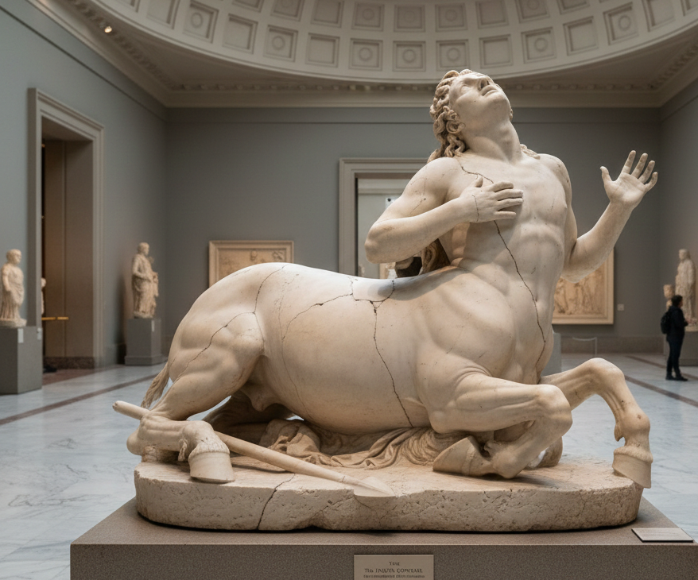
Centaur Collapse
A good team does not diminish its human members for the sake of the whole.
Scholars need to retain key abilities for scholarship.
Is there good cognitive debt?
How do we know what the right balance is?
Generated by Nano Banana

Slide 31
Conclusion: Man’s Search for Meaning
Slides: soc-n.us/270126-research-manifold
Wide context and not just long context.
What do we want research to be?
Do we want to go along for the ride?
Thanks to WING members Haomeng Lu, Nura Tamton, Rui Feng Cheong, Xuan Long Do, Sahajpreet Singh, Yisong Miao for their work,
To WING’s sabbatical visitors Haitao Yu and Joeran Beel, Moritz Baumgart for their AI Science discussions,
To our local SG NLP group, especially Nancy Chen, Zhengyuan Liu and Lizi Liao for their discussion at SSNLP,
to the AI4Research organisers for the license to let me have an excuse to free associate!

